Slide 1
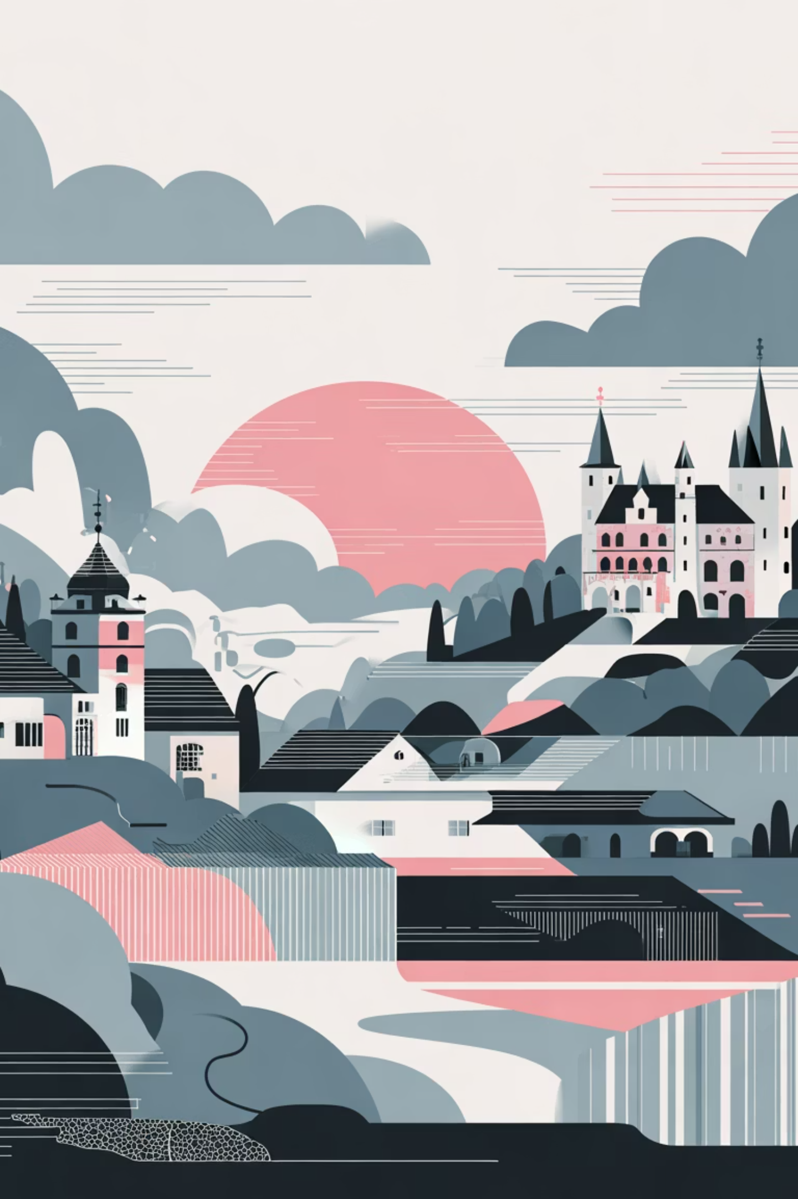
Das Perfekte Deutsche Reiseroute
Your 7-Day German Adventure
Discover the soul of Germany through history, culture, and unforgettable experiences. From Berlin's vibrant streets to Munich's Alpine majesty, this itinerary captures the essence of Germany's most compelling destinations.

Slide 2
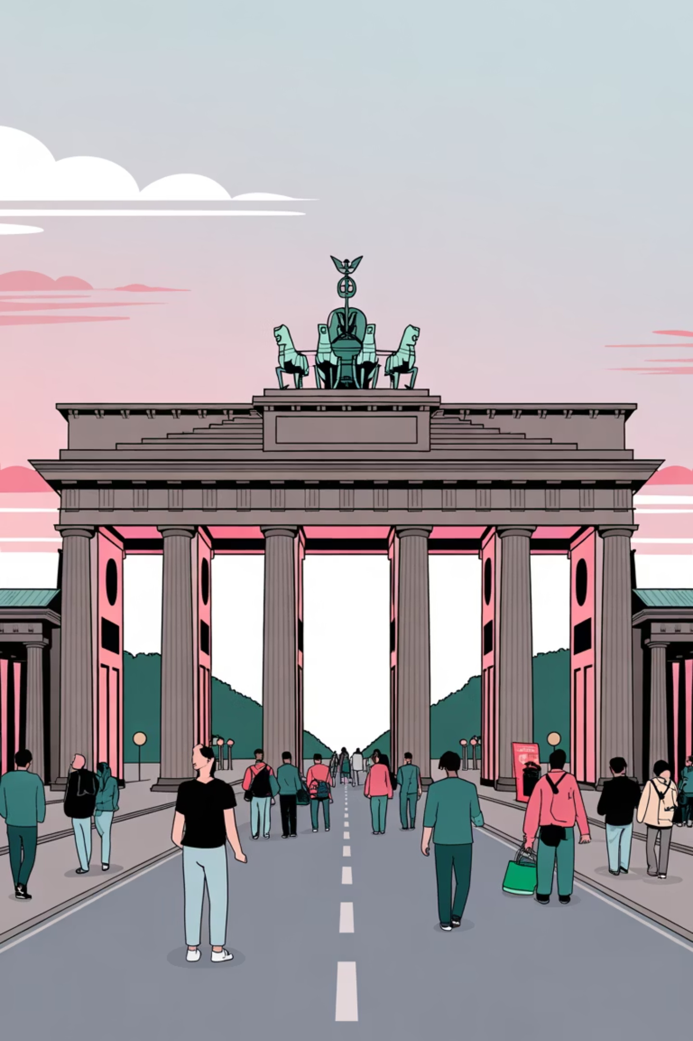
Day 1-2: Berlin's History & Modern Pulse
Start in Germany's electric capital, where Cold War relics stand beside cutting-edge galleries and restaurants. Berlin is a living museum of 20th-century history intertwined with contemporary creativity.
Must-See Attractions
Budget Breakdown
Brandenburg Gate & Reichstag
Accommodation: €60–100/night
Berlin Wall Memorial
Meals: €30–50/day
Museum Island (UNESCO site)
Attractions: €35–45/day
East Side Gallery
Transport: Day pass €8
Cultural Tip
Berliners value directness and authenticity. Skip the tourist traps in Charlottenburg and explore Kreuzberg's street art scene. Many museums offer free entry after 6 PM on Thursdays.

Slide 3
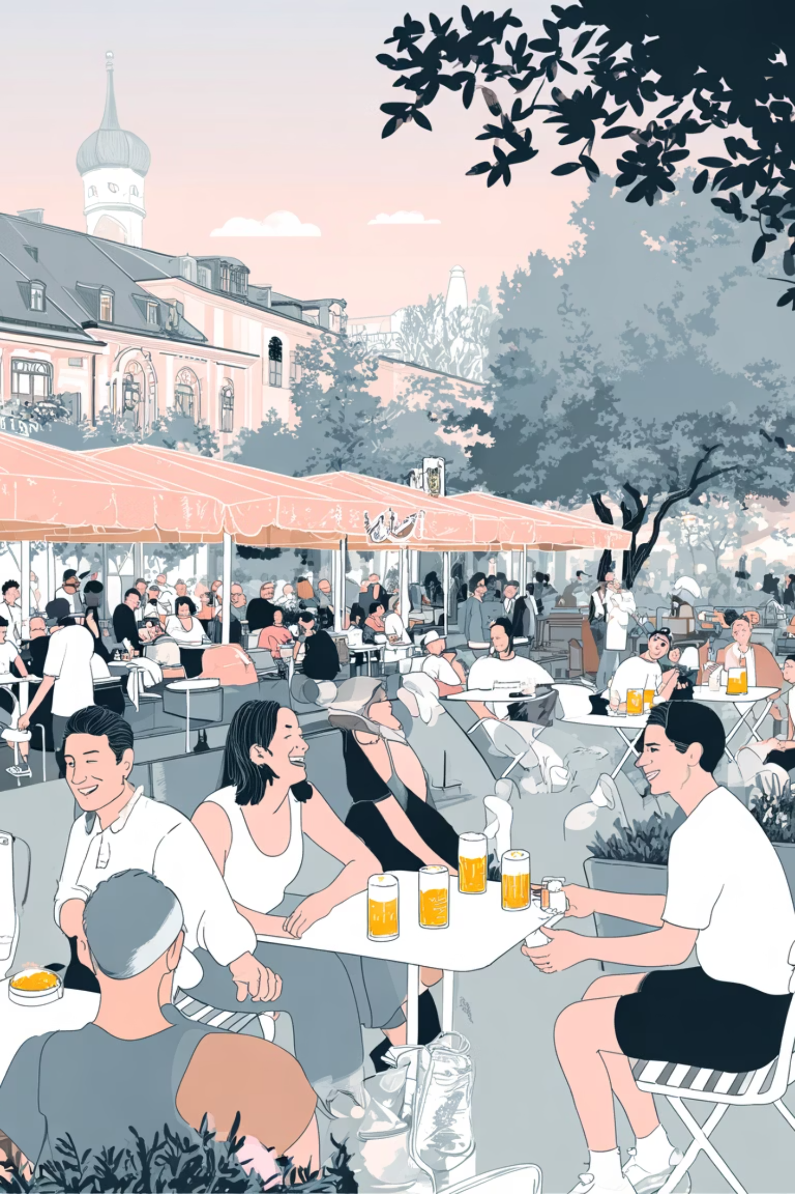
Day 3-4: Munich's Bavarian Charm & Alpine Views
Experience the heart of Bavaria in Munich, where beer gardens overflow with laughter, traditional dress is still worn with pride, and Alpine peaks frame stunning vistas. The city blends royal history with convivial warmth.
Signature Experiences
Budget Essentials
Marienplatz & Glockenspiel
Accommodation: €55–90/night
English Garden (world's largest)
Meals: €25–45/day
Neuschwanstein Castle day trip
Attractions: €40–50/day
Day trip train: €30–40
Nymphenburg Palace
Beer hall culture

Slide 4
Day 5: Romantic Road - Rothenburg ob der Tauber
Step into a storybook on the Romantic Road. Rothenburg preserves medieval charm with intact town walls, half-timbered houses, and cobblestone streets that transport you back centuries. It's Germany's most enchanting small town.
What to Do
Budget
Insider Tip
Walk the town walls for panoramic views, explore the Medieval Crime & Punishment Museum, visit St. James Church for its intricate altar, and browse artisan shops selling handcrafted goods.
Day trip from Munich: €30–40 train fare. Meals: €20–35/day. Accommodations (optional overnight): €50–75/night. Most attractions: €5–8 each.
Arrive early morning or stay overnight to experience the town without cruise ship crowds. The Night Watchman's tour (7:30 PM) offers authentic local history and humor in English.

Slide 5
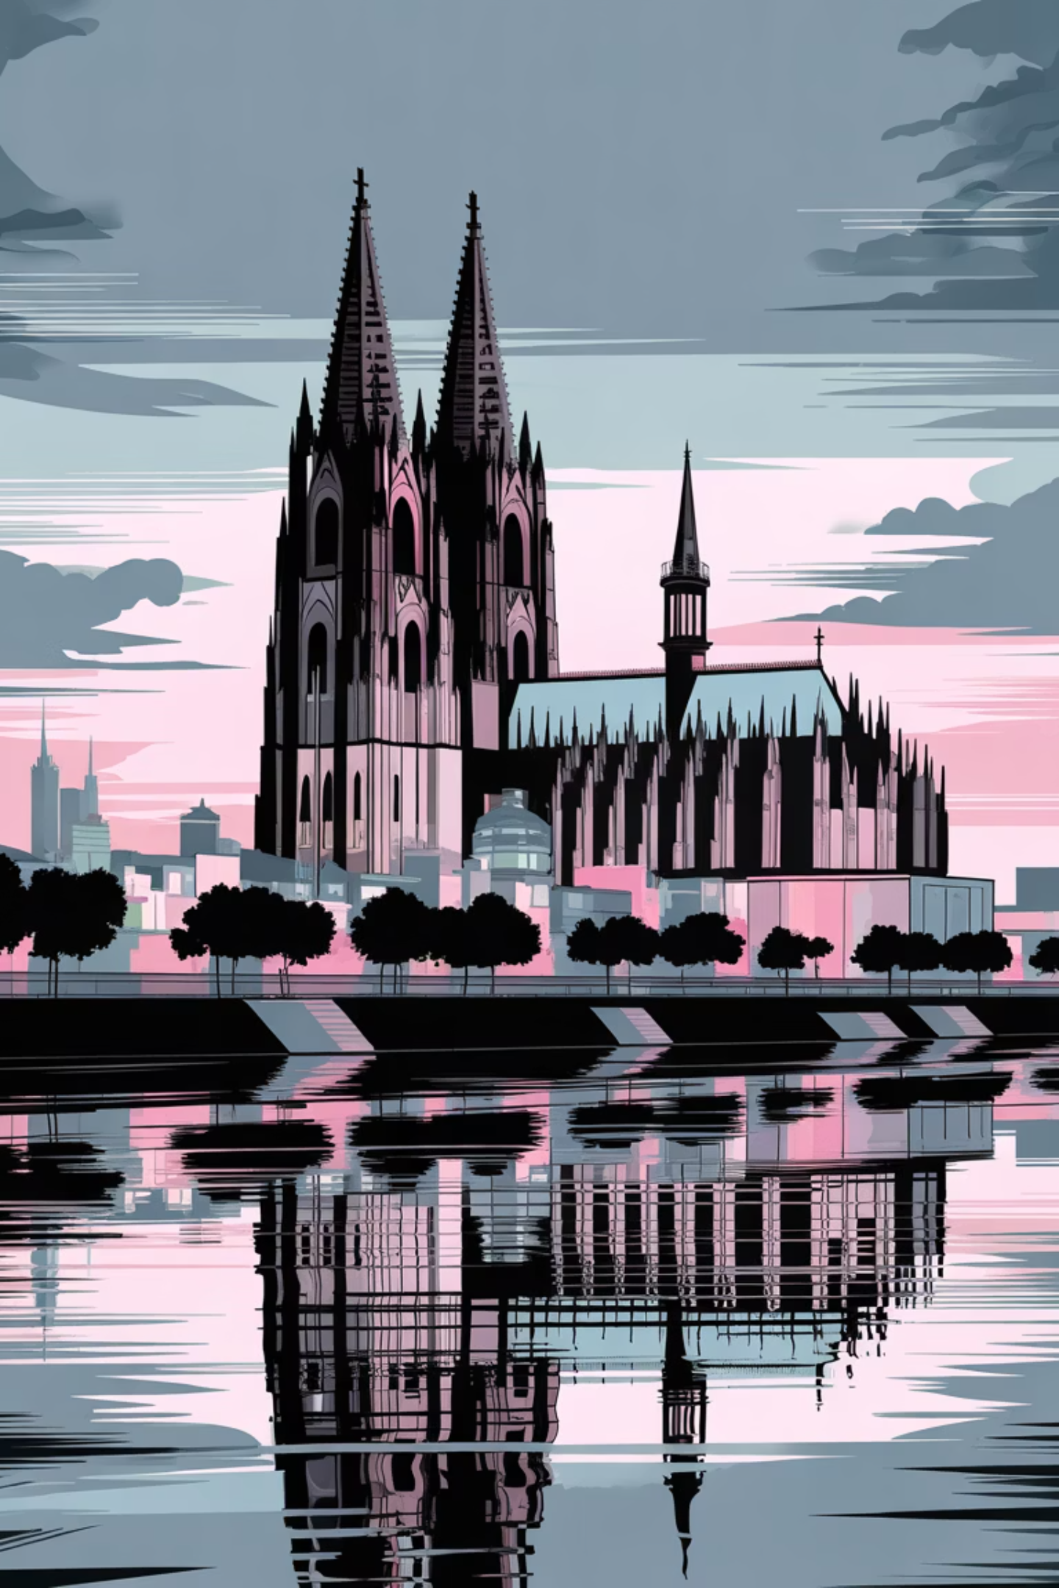



Day 6: Cologne's Cathedral & River Rhine
Cologne showcases Gothic grandeur and Rhineside romance. The UNESCO-listed cathedral dominates the skyline, while the riverside neighborhoods pulse with galleries, beer halls, and the convivial spirit of the Rhineland.
Cologne Cathedral
Climb 533 steps for aerial views; UNESCO masterpiece of Gothic architecture
Rhine River Cruise
Scenic boat tours reveal vineyards and castle ruins along Germany's most romantic stretch
Museum Quarter
Over 30 museums explore art, history, and culture within walking distance

Slide 6
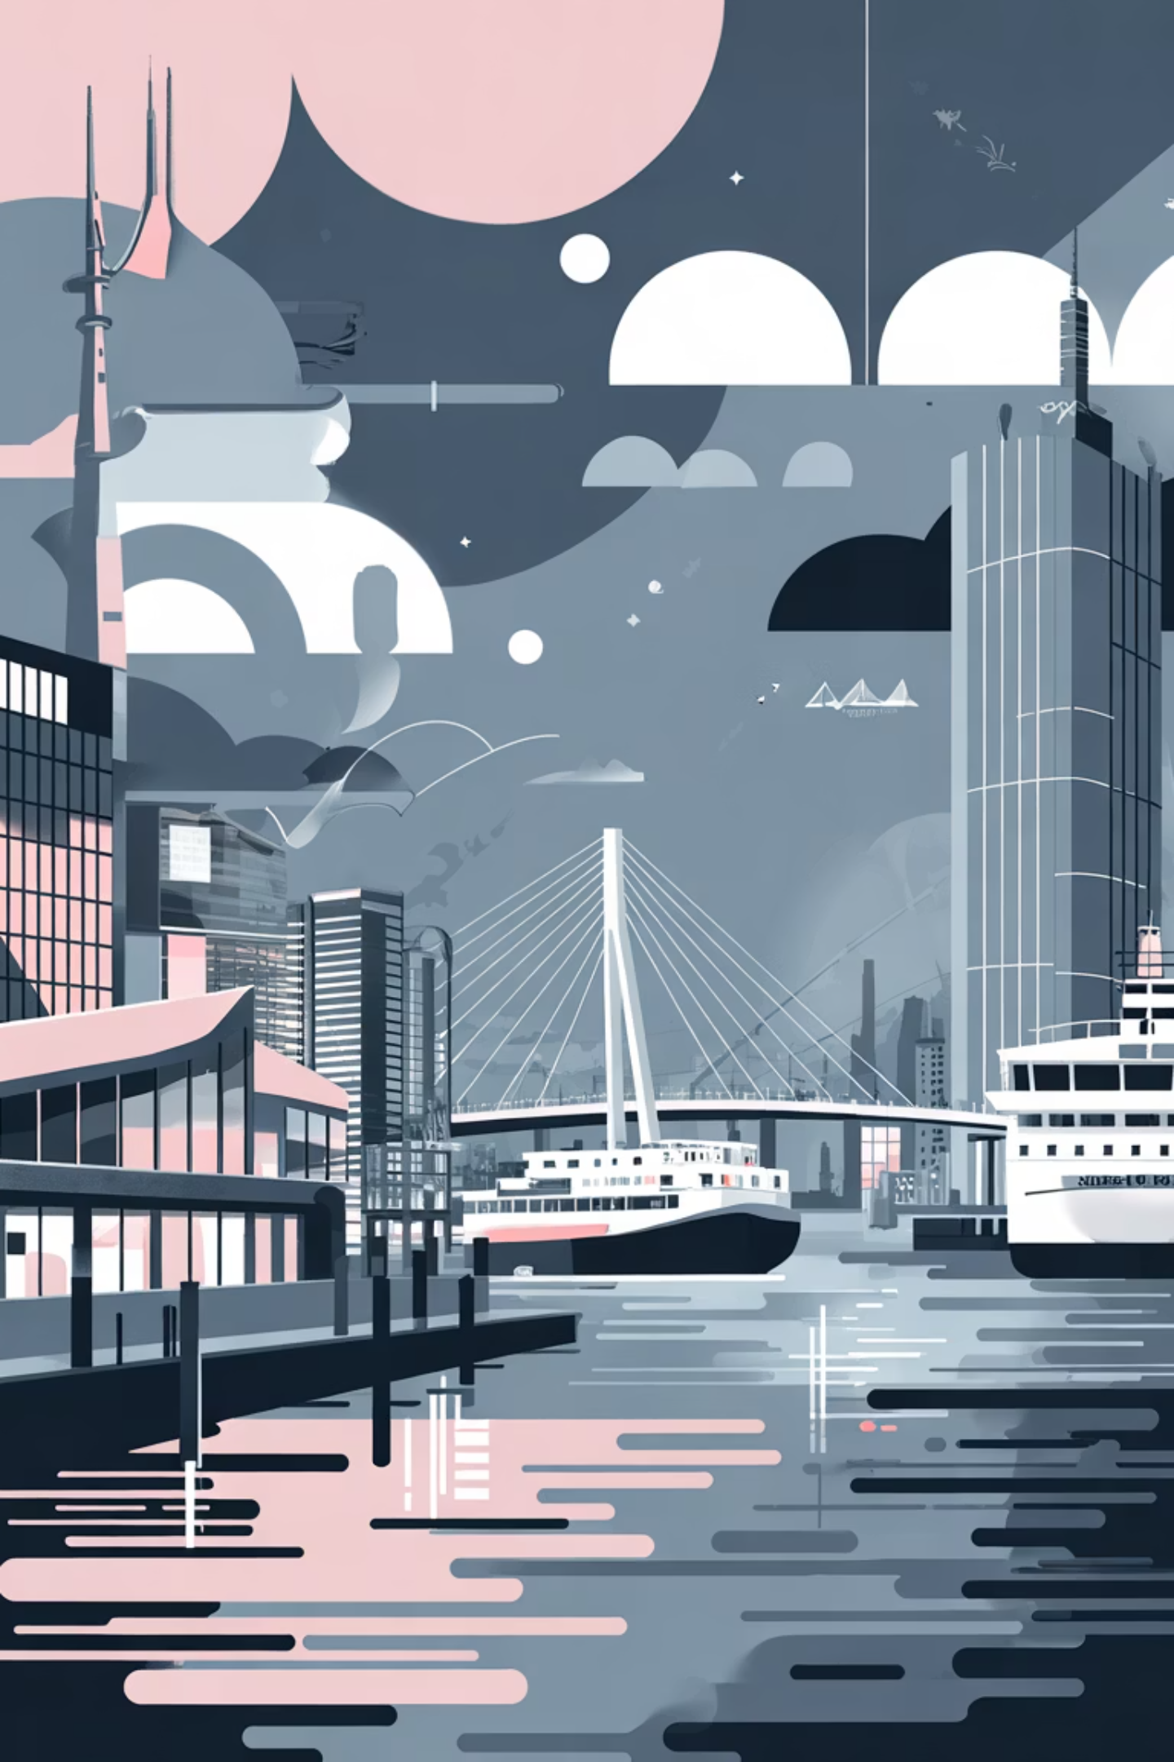
Day 7: Hamburg's Maritime Spirit & Nightlife
End your journey in Hamburg, Germany's gateway to the world. This port city blends maritime heritage with cosmopolitan energy, featuring world-class museums, the iconic Reeperbahn nightlife district, and waterfront charm.
Must Experience
Budget & Logistics
Miniatur Wunderland (world's largest model railway)
Train from Cologne: €60–90
Accommodation: €60–95/night
Port Authority building & harbor tour
Meals: €30–50/day
Attractions: €15–25/day
Kunsthalle museum
Reeperbahn entertainment district

Slide 7
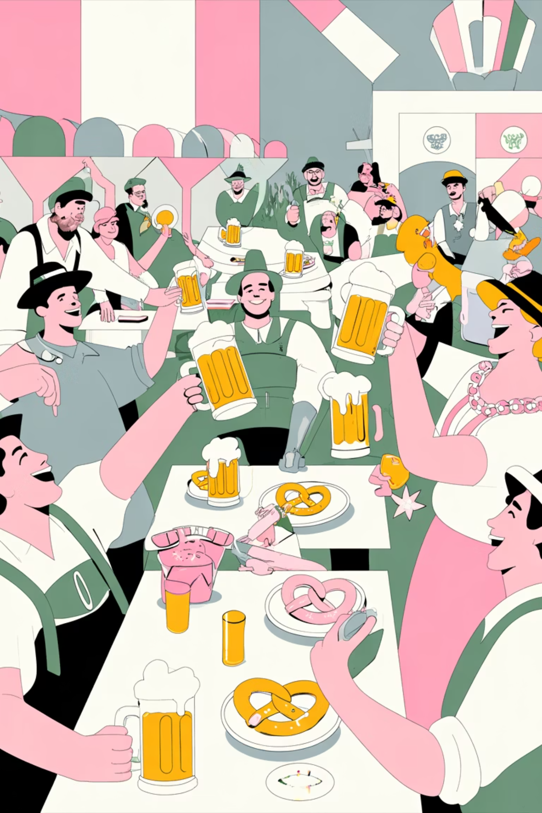
Key Takeaways & Cultural Survival Guide
Maximize your German experience with these essential insights and practical wisdom.
1
Embrace Directness
Germans value honesty over politeness. Bluntness isn't rude—it's respectful. They appreciate straightforward questions and clear communication.
2
Respect Punctuality
Being late is disrespectful in German culture. Trains run on time; so should you. Plan buffer time for connections.
3
Master Payment Etiquette
Carry cash—many cafés and shops don't accept cards. When dining, keep the bill and hand cash to your server; tipping 5-10% is customary.
4
Budget Reality: €90–150/Day
Total 7-day estimated cost: €630–1,050 per person (accommodation, food, transport, attractions). Germany offers exceptional value compared to Western Europe.

